Slide 1
Python expressions and variables

Slide 2
Evaluation
Value | Operator | Value
1 | + | 2
evaluation
Value
3
print(1+2)
print(3)

Slide 3
Precedence
Value | Operator | Value
1 | + | 4
Value | Operator | Value | Operator | Value
1 | + | 2 | * | 2
Value
5
print(1+2*2)
print(3)

Slide 4
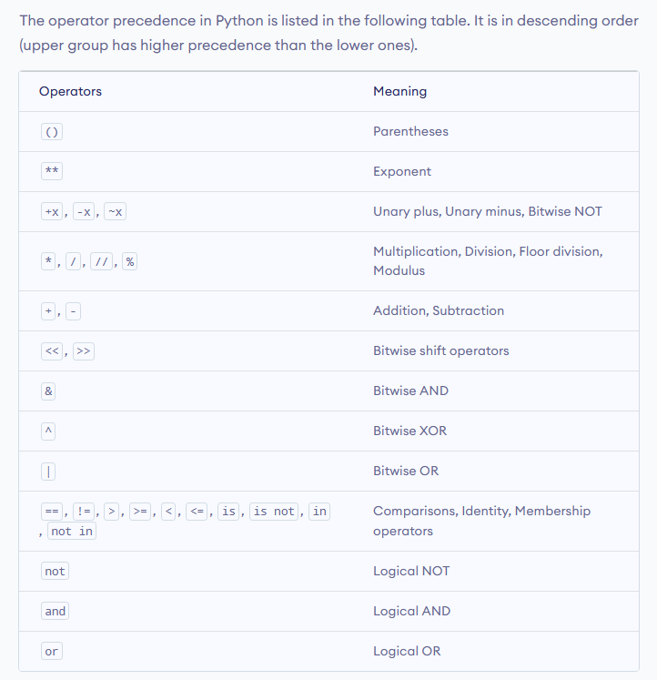
Precedence
1+2*2
Value
5
(1+2)*2
Value
6

Slide 5
Types – סוגים \ טיפוסים
INT | String
1 | “1”
2 | “1+1”
1,000,000 | “this is also a string”

Slide 6

Context
1+1
Value
2
“1”+”1”
Value
“11”
1+”1”

Slide 7


Variables - משתנים
1997
2024
What is your year of birth?
27
1997
What year is it now?
2024
You are 27 years old

Slide 8
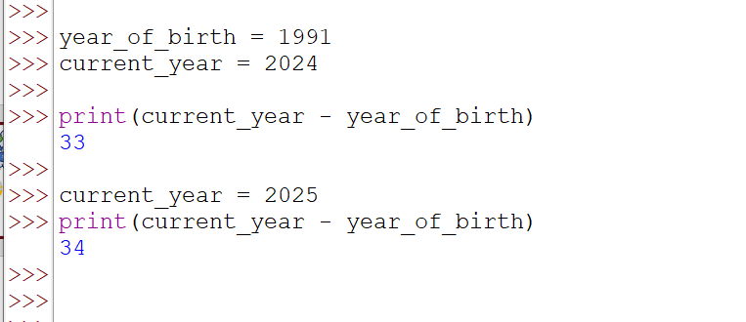
Variables
Creating variables
Using variables
Updating variables

Slide 9
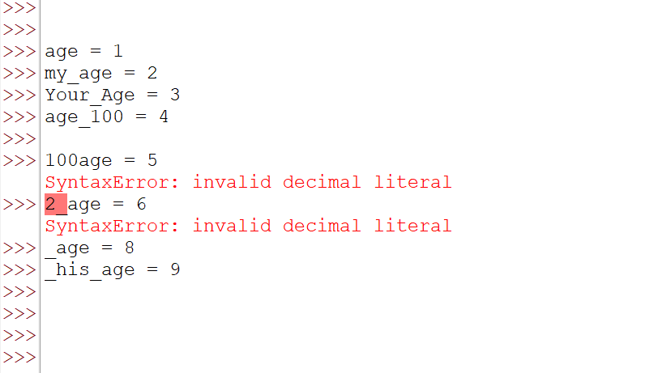
Variable naming
Starts with letter
Use letters, ‘_’ (underscore) or numbers
Any length
Lower case or upper case letters
The best practice in python is to use lowercase letters separated by ‘_’ for variable names

Slide 10
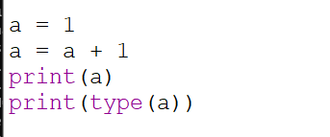
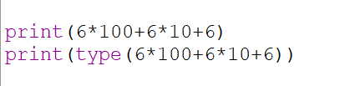

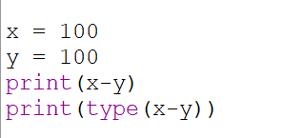
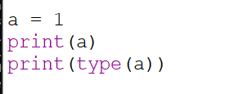
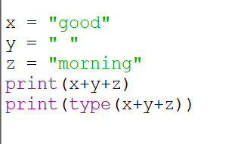
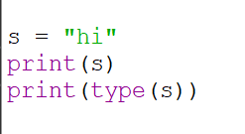
Try it …

